Slide 1
Coupa Supplier Portal (CSP) Training
Setting up your CSP account

Slide 2
Contents
Pages 4 - 6 | Registering for the Coupa Supplier Portal
Pages 7 - 8 | Accepting Term of Use for e-Invoicing
Page 9 - 26 | Setting up Legal Entity information
Pages 27 – 28 | Shipping & Handling Charge
Pages 29 - 30 | CSP Address Codes in cXML Invoice

Slide 3
Registering for the Coupa Supplier Portal (CSP)

Slide 4
Registering for CSP
When Nationwide invites you to join the Coupa Supplier Portal you will receive an invitation e-mail.
1. Open the email containing your registration link. The e-mail will have the subject line: Nationwide Registration Instructions – Action Required
2. Click on the e-mail to open it.
Please NOTE:
Before Coupa goes live, the registration email and link will be sent to the contact for which we received from our Supplier Enablement communications. You can update this information once you have logged into the CSP for the first time.

Slide 5
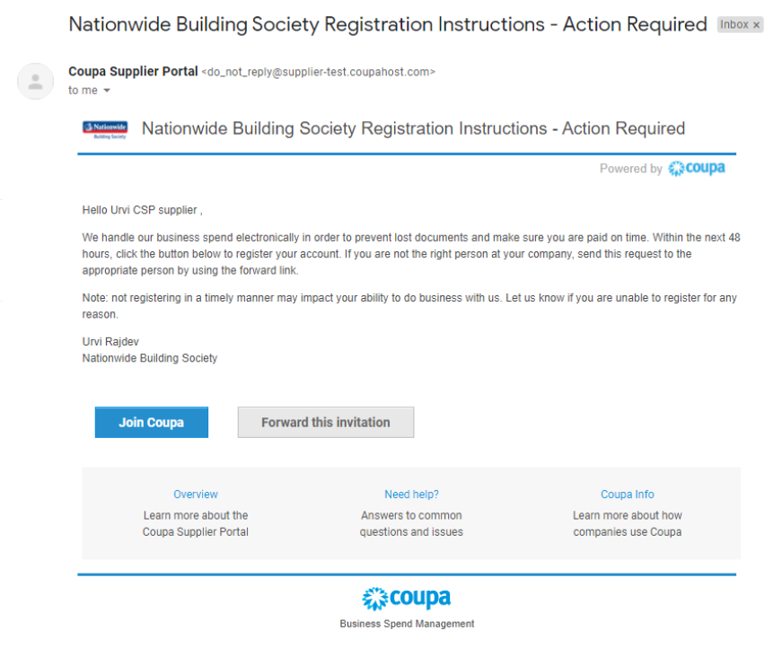
Registering for CSP
Click on the Join Coupa button at the bottom of the email.

Slide 6
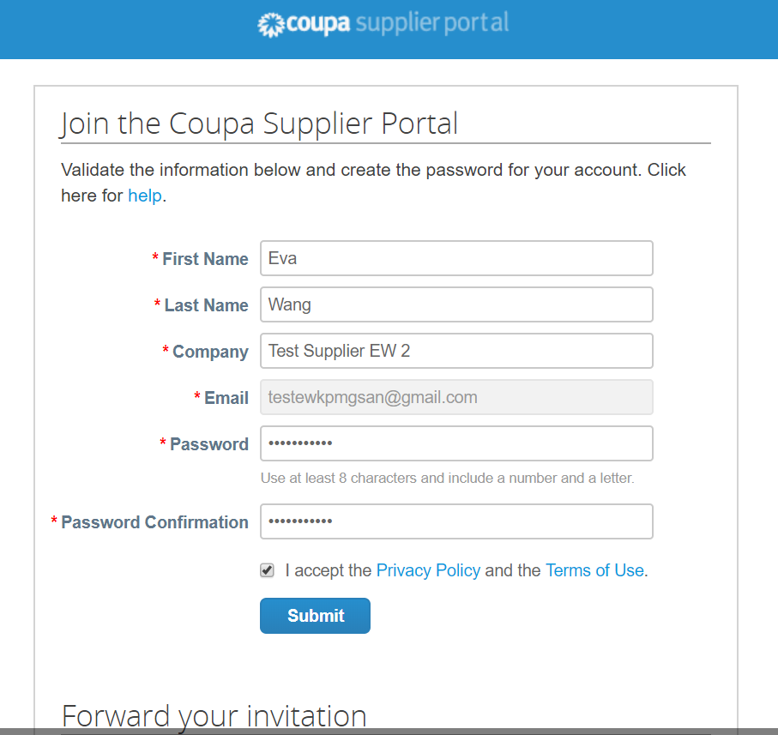
Registering for CSP
Complete the following fields:
First name
Last name
Company
Department (choose from Sales, Operations, Account Receivable, Treasury or Other)
Role (choose from the drop-down list that is driven by Department. ‘Other’ option is always available)
Password
Password confirmation
Accept the Privacy policy and terms of use of registering in Coupa and click Submit.
Add the URL supplier.coupahost.com to your bookmarks by clicking on the star icon (In IE & Chrome browsers) for future use.

Slide 7
Accepting Terms of Use for e-Invoicing

Slide 8
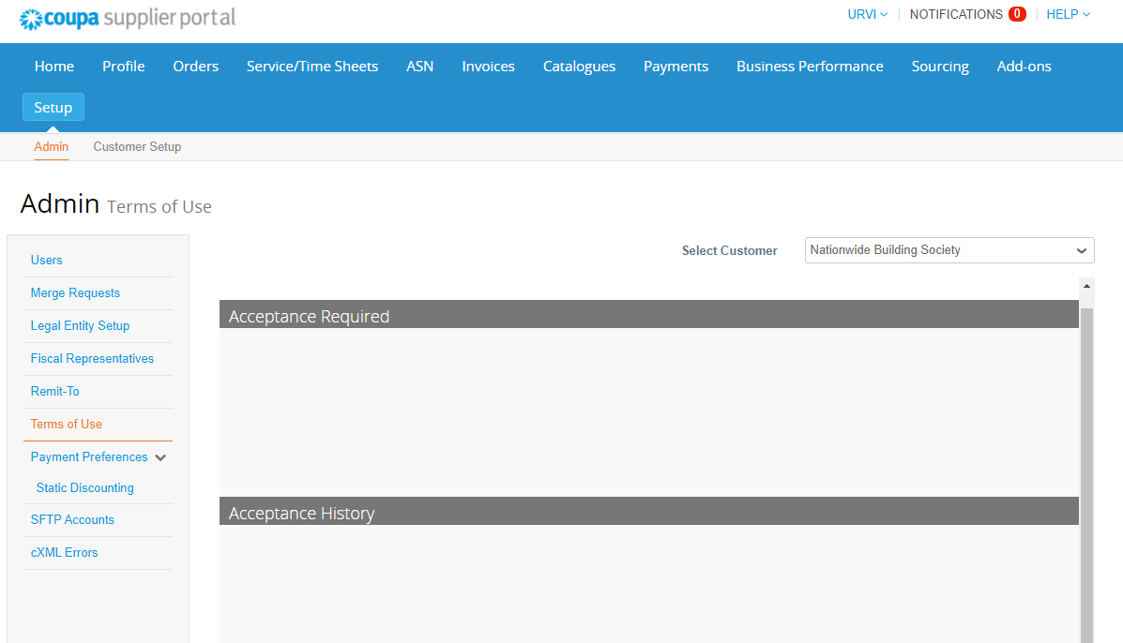
Accepting Terms of Use
1. Go to Setup, and choose Terms of Use. Accept Terms of Use by clicking I Accept.
2. The Acceptance History shows when you’ve accepted the Terms of Use.
Please NOTE: As part of the Coupa terms and conditions you explicitly agree to Coupa issuing invoices on your behalf.
From a VAT perspective, this means that the PDF generated by Coupa is your legal invoice (as well as Nationwide as your customer).
You must archive this invoice in line with your legal retention periods and requirements. You should not attach (or issue to Nationwide) an invoice from your system after signing up to these terms.

Slide 9
Setting up Legal Entity information

Slide 10
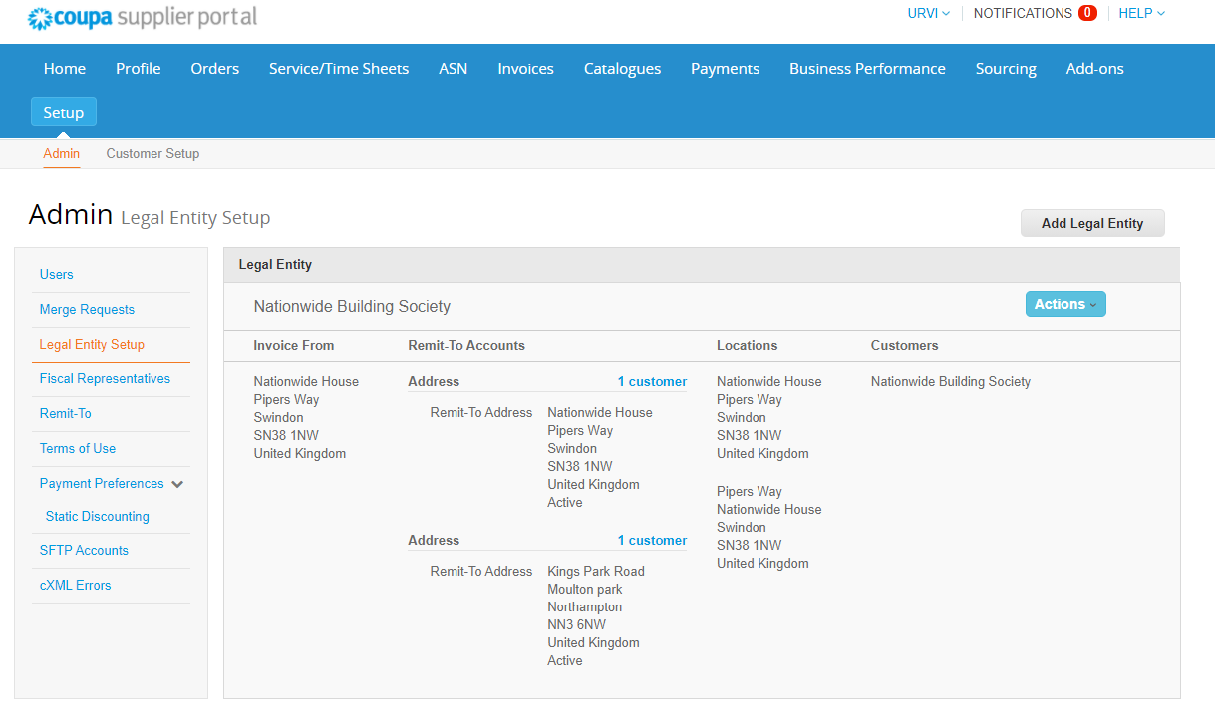
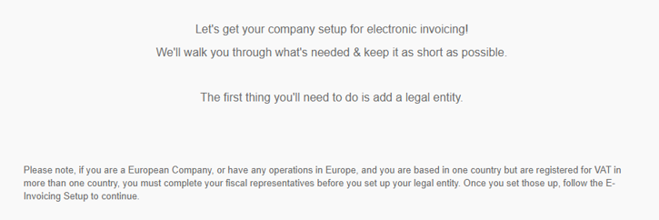
Setting up Legal Entity Information
1. Once you are logged into the CSP, click on Setup in the top menu. Then click on Legal Entity Setup.

Slide 11
Setting up Legal Entity Information
2. Then click on Add Legal Entity.
Please NOTE:
All data used in the Legal Entity structure goes on to the legal invoice that Coupa produces. Please ensure this information is accurate.

Slide 12
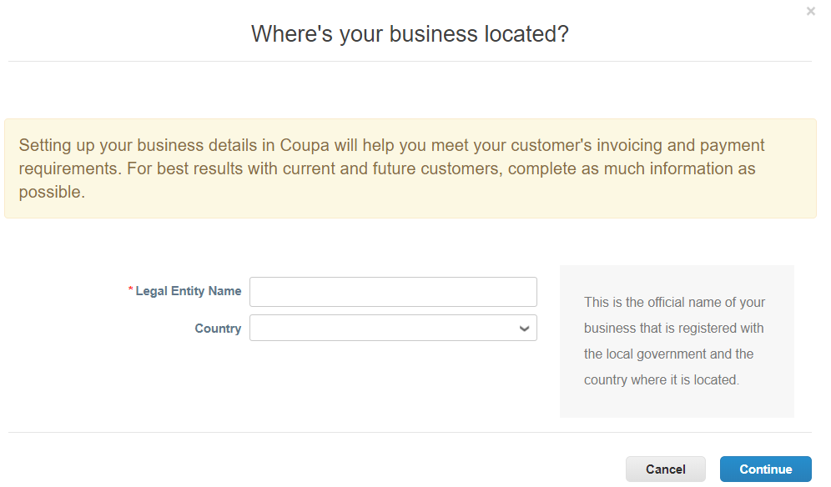
Setting up Legal Entity Information
Enter the Legal Entity Name for your company and select the Country. Then click Continue.

Slide 13
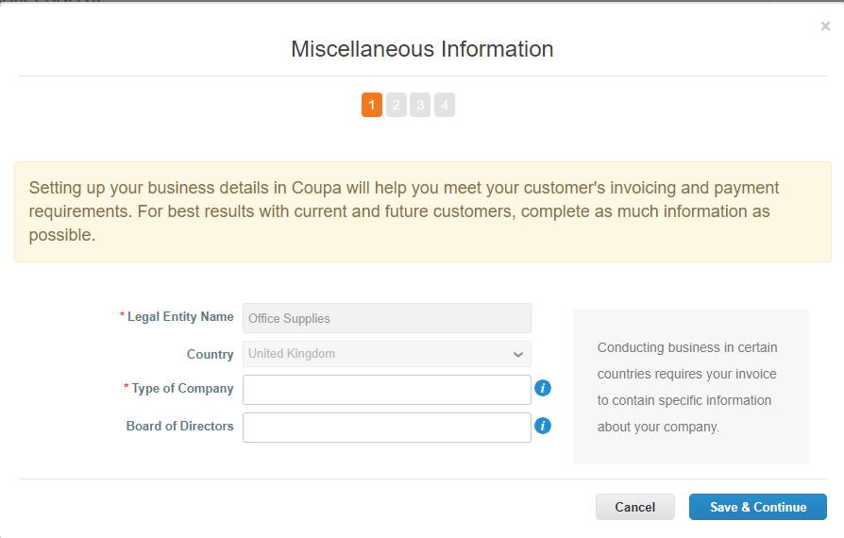
Setting up Legal Entity Information
4. Enter Type of Company (e.g. Limited, LLP etc.) and then click Save & Continue.

Slide 14
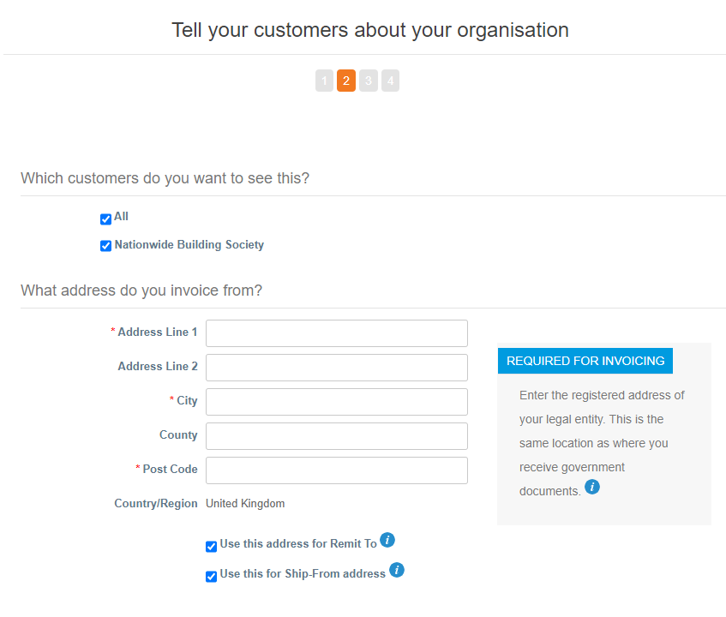
Setting up Legal Entity Information
5a. Complete the required information:
Which customers do you want to see this? Select: Nationwide
What address do you invoice from? Enter an invoice address. To use this as the Remit to and/or Ship From address, select the appropriate check boxes.

Slide 15
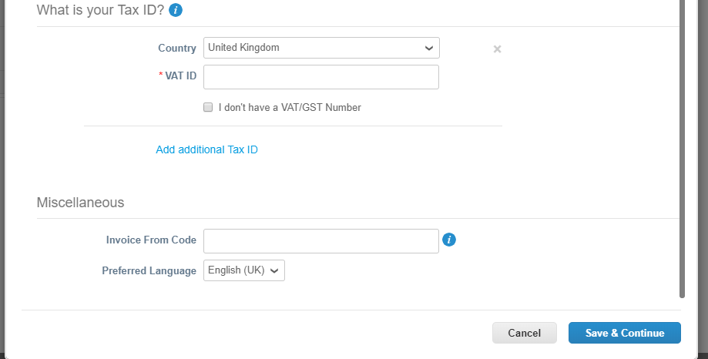
Setting up Legal Entity Information
5b. Complete the required information:
What is your Tax ID:? Enter your tax country and your local VAT/GST ID number in that country. Click on Add additional Tax ID if you have other VAT/GST numbers issued by other countries, which will be used to invoice Nationwide, and enter the relevant country/VAT ID details.
Miscellaneous: Enter an Invoice From Code and a preferred language to use in the CSP.
5c. If you don’t have a VAT ID, you can check the I don’t have a VST/GST Number box. Then fill in the Local Tax ID field.
Then click Save & Continue .
Please NOTE:
If you are VAT registered, please ensure your VAT registration number is correct and relates to the country specified - as this information will be used by Coupa to generate a tax invoice on your behalf.
Create an Invoice From Code and reference it in your cXML invoices would enhance the success of cXML invoice address information matching with CSP.
If you ticked the box to use Invoice From Address as Remit to and/or Ship From address (step 5a), they will have the same code as the Invoice From Address.
If you ticked the box to use Invoice From Address as Remit-To, you HAVE TO create a code for it.

Slide 16
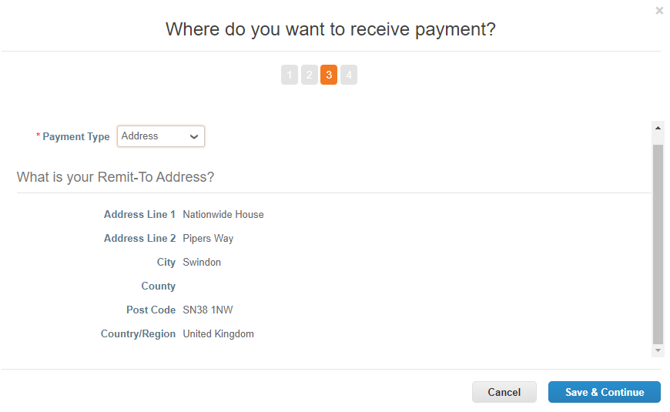
Setting up Legal Entity Information
6a. Where do you want to receive payment? Choose Bank Account from the Payment Type dropdown
Complete What is your Remit-To Address? The Remit-To Address is auto populated because the box of ‘Use this Address for Remit-To’ in step 5a. was ticked.
Click Save & Continue

Slide 17
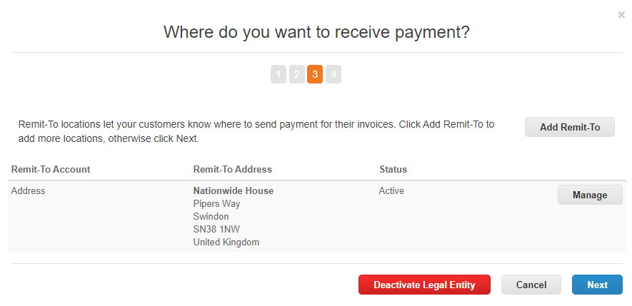
Setting up Legal Entity Information
6b. Where do you want to receive payment?
Review your Remit-To Account.
Click Add Remit-To if you want to add another remit-to account.
Click Next if you wish to continue.

Slide 18
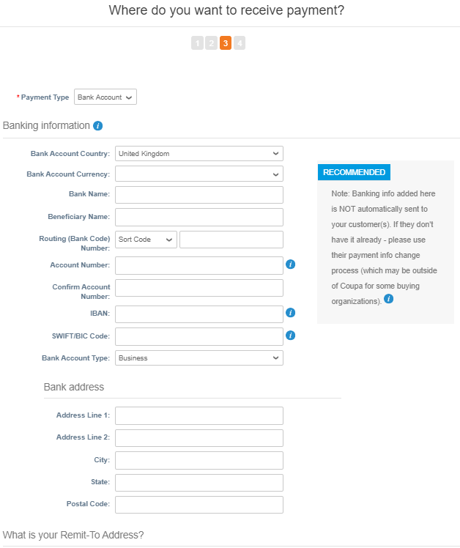
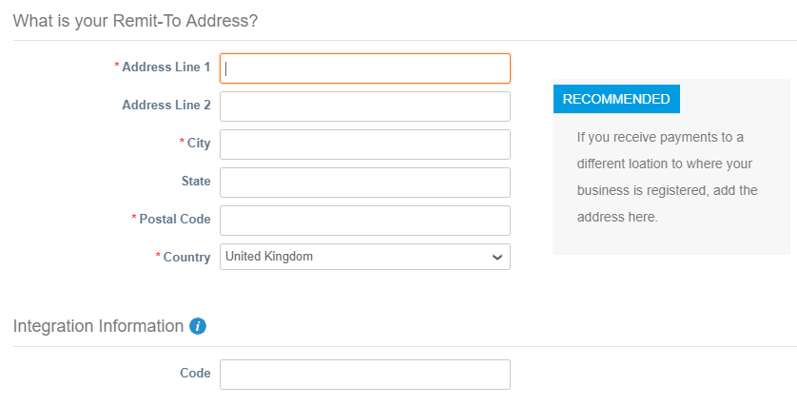
Setting up Legal Entity Information
6c. If selected Add Remit-To in step 6b:
Choose Bank Account from the Payment Type dropdown and enter your Bank Information
Complete What is your Remit-To Address?
Code: Create a new code for this new remit-to address in Integration Information
Please NOTE:
As you will use cXML method to send invoices, you HAVE TO create a new code for this new Remit-To address and reference it in your cXML invoice.

Slide 19
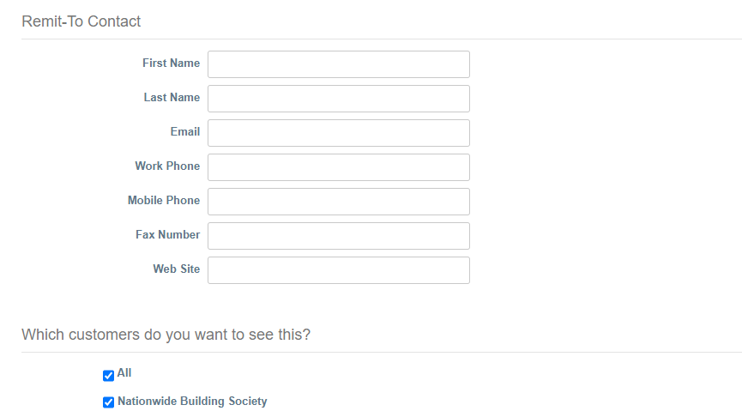
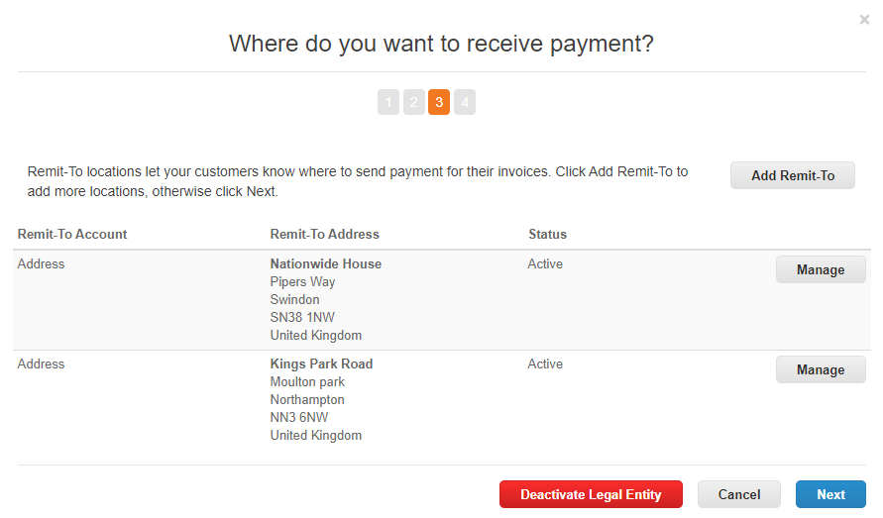
Setting up Legal Entity Information
6c. If you selected Add Remit-To in Step 6b, check the box Nationwide under Which customers do you want to see this?
Remit-To Contact is optional.
Click Save & Continue. Then Click Next

Slide 20
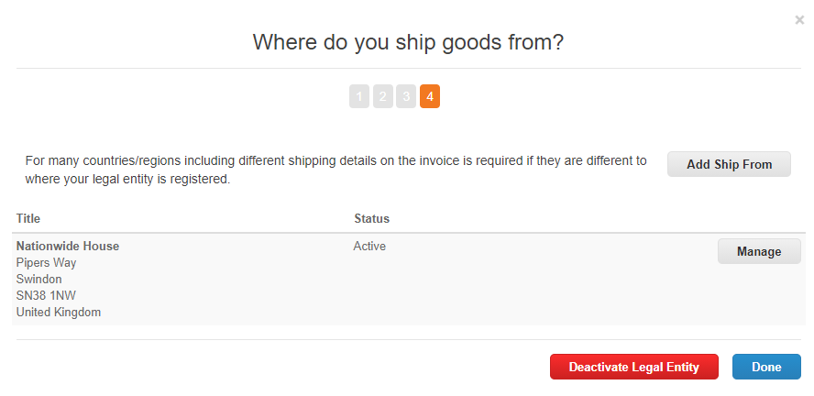
Setting up Legal Entity Information
7a. Where do you ship goods from? If you ship goods from a location different to the address that you invoice from, click Add Ship From and add a new address. If you would like to use the same address, click Done.
Please NOTE: It is important for tax purposes that you reflect where you ship goods from when it is different to your legally registered country.
For example, if you are registered in the UK but ship goods from a warehouse in Poland, please ensure that you add this address here to reflect this accurately when it comes to creating invoices.
If (as may be the case in the above example) you are required to raise an invoice using a VAT ID that differs from the VAT ID shown against your Coupa legal entity information (i.e. the VAT number issued by your country of residence/incorporation), you will need to add an additional VAT against your legal entity and send this VAT ID in your cXML file to Coupa when transmitting invoice data via the cXML file- Please refer to slide 21.

Slide 21
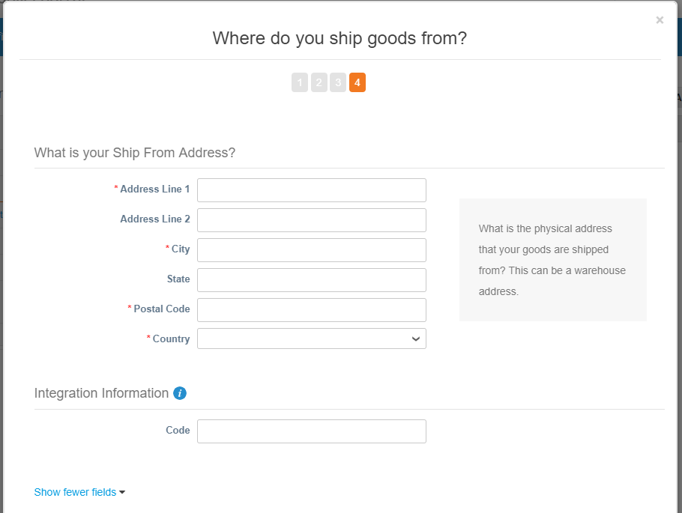
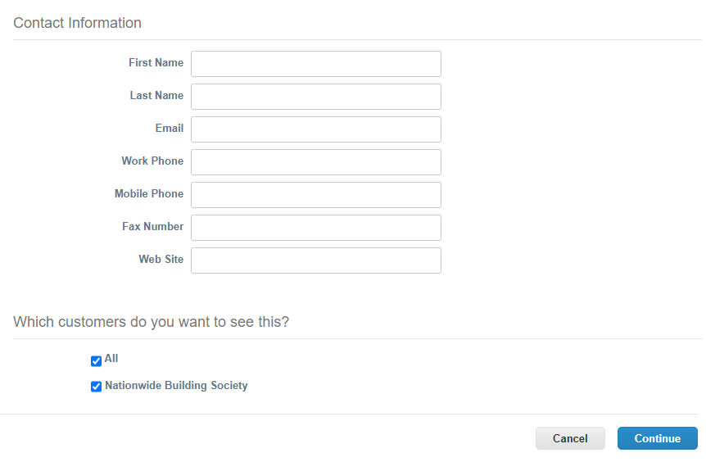
Setting up Legal Entity Information
7b. If you choose Add Ship From in the step 7a, complete the required fields:
What is your Ship From Address?
Integration Information: create a new code for this new address
Contact Information is optional
Which customers do you want to see this? Select Nationwide
Click Continue.
Please NOTE:
Create a Ship From Code and reference it in your cXML invoices would enhance the success of cXML invoice address information matching with CSP and is strongly recommended.

Slide 22
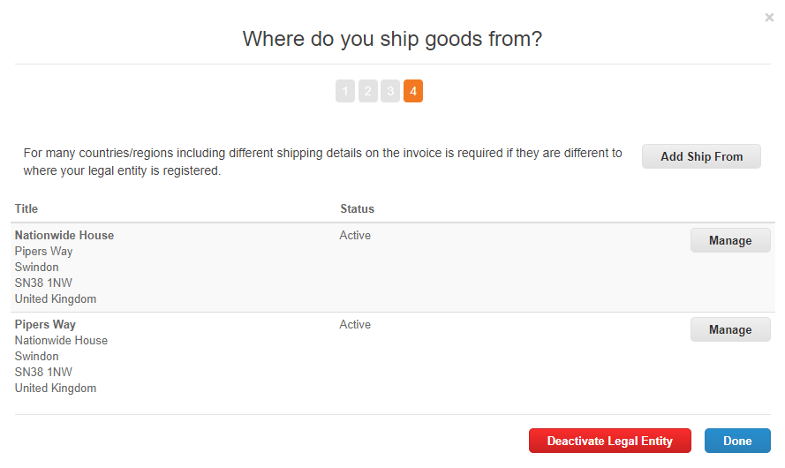
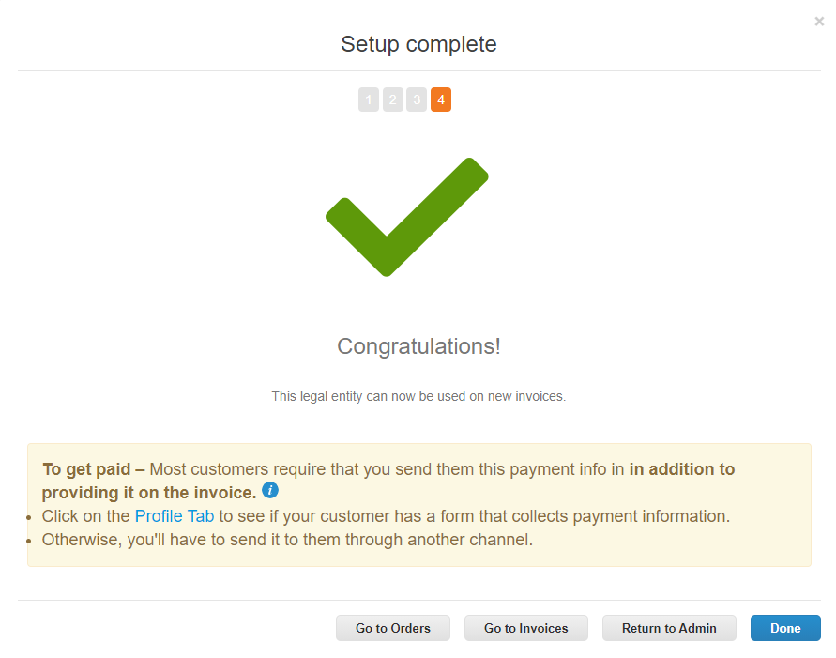
Setting up Legal Entity Information
7c. Click Done once you’ve confirmed your ship goods from address.
8. You will then see a Setup Complete pop-up window. Click Return to Admin to go back to the main interface.

Slide 23
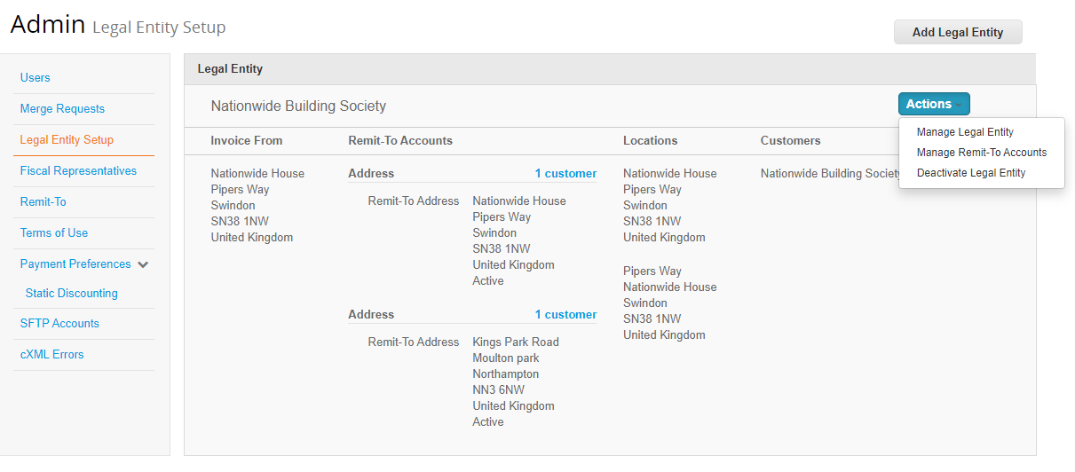
Setting up Legal Entity Information
9. After saving a Legal Entity, it will appear in the E-Invoicing Setup section under Admin. Click on the Action button for eah legal entity. You can see three options: Manage Legal Entity, Manage Remit-To Accounts and Deactivate Legal Entity.
10a. Click on Manage Legal Entity. You can change the customer that you want to see this legal entity as well as add or deactive Remit-To Account and Ship-From Address for this legal entity.

Slide 24
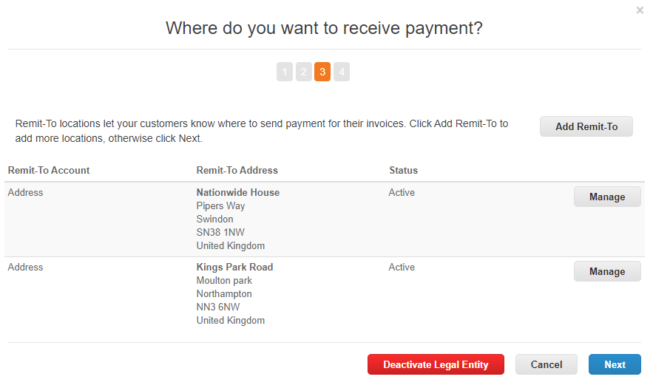
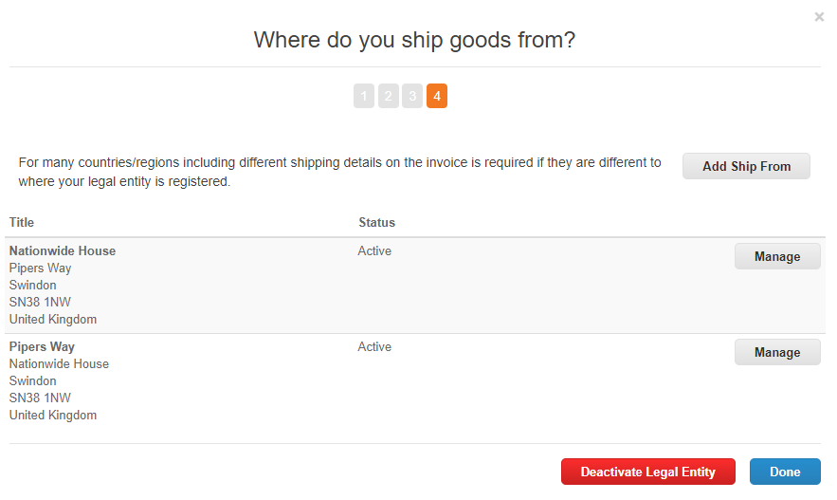
Setting up Legal Entity Information
10b.Click on Manage Legal Entity. And then click on Manage beside each address/account. You can check the codes that you setup for them.
z

Slide 25
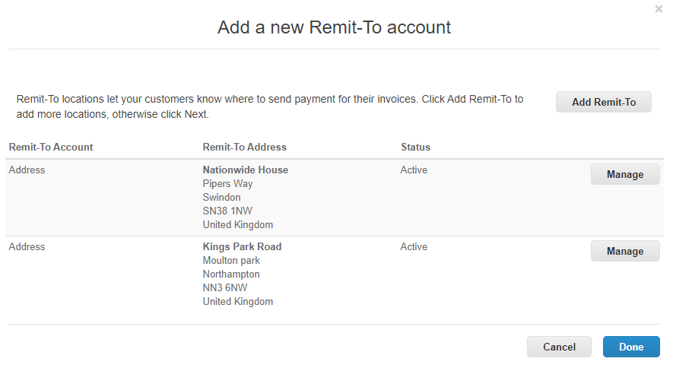
Setting up Legal Entity Information
10c.Click on Manage Remit-To Accounts. You will be directed to the Remit-To accounts page of that Legal Entity. You can Add Remit-To here.
Click on Manage beside each Remit-To Account. You can check the Remit-To codes that you setup for them and change the customers that can see this account.

Slide 26
Setting up Legal Entity Information
11. If you made a mistake, i.e. entered and saved a wrong VAT ID, Address, forgot to create a address code, etc. you cannot amend the saved information.
You will have to click on Deactivate Legal Entity and the whole record of that legal entity will be deactivated. The information will be gone from your Legal Entity Setup section.
12. You will then have to click on Add Legal Entity and re-enter a new legal entity information from the begining.

Slide 27
Shipping & Handling Charge

Slide 28
Shipping & Handling Charge
Where it is agreed that your invoice will include a shipping and/or a handling charge (as opposed to any shipping and/or handling cost being factored into the underlying price of the goods), this needs to be provided to Coupa at invoice summary level.
To ensure your invoice is compliant with VAT regulations, you have to put VAT against shipping and handling charges at the invoice summary level.
Where a PO line subjects to different rates of VAT are to be invoices, you will need to split your invoices to ensure VAT compliance. Then you need to put shipping and handling charges accordingly.
To use cXML invoicing method, you need to include details of your shipping and handling charges and the applicable VAT in the <InvoiceDetailSummary> section in the cXML invoices.

Slide 29
CSP Address Codes in cXML Invoice

Slide 30
CSP Address Codes in cXML Invoice
Remit-to Address
Invoice-from Address
Ship-from Address
<InvoicePartner>
<Contact role="remitTo" addressID=“CSPAddressID01">
<Name xml:lang="en-GB">XXXX</Name>
<PostalAddress>
<Street>XXX</Street>
<Street>XXX</Street>
<City>XXX</City>
<State>XXX</State>
<PostalCode>XXX</PostalCode>
<Country isoCountryCode="GB">United Kingdom</Country>
</PostalAddress>
</Contact>
</InvoicePartner>
<InvoicePartner>
<Contact role="invoiceFrom" addressID=“CSPAddressID02">
<Name xml:lang="en-GB">XXXX</Name>
<PostalAddress>
<Street>XXX</Street>
<Street>XXX</Street>
<City>XXX</City>
<State>XXX</State>
<PostalCode>XXX</PostalCode>
<Country isoCountryCode="GB">United Kingdom</Country>
</PostalAddress>
</Contact>
</InvoicePartner>
<InvoiceDetailShipping>
<Contact role="shipFrom" addressID=“CSPAddressID03">
<Name xml:lang="en-GB">XXXX</Name>
<PostalAddress>
<Street>XXX</Street>
<Street>XXX</Street>
<City>XXX</City>
<State>XXX</State>
<PostalCode>XXX</PostalCode>
<Country isoCountryCode="GB">United Kingdom</Country>
</PostalAddress>
</Contact>

Slide 31
Close slide dark blue

