Slide 1

Coupa Supplier Portal (CSP) Training
Purchase Orders, Invoices & Credit Notes

Slide 2
Contents
Pages 3 - 14 | Viewing and Acknowledging a PO
Pages 15 - 23 | Flipping a PO into an Invoice
Pages 24 – 31 | Creating Credit Notes
Pages 32 – 35 | Viewing Invoices & Credit Notes
Pages 36 - 37 | Tax Guidance

Slide 3
Viewing and Acknowledging a PO

Slide 4
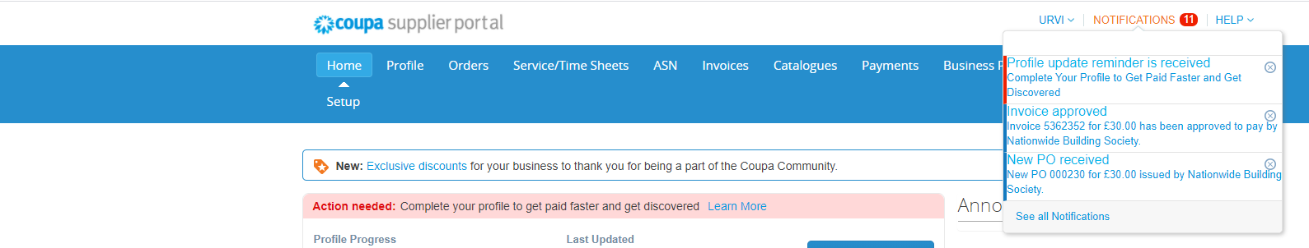
Viewing a Purchase Order
When Nationwide issues a Purchase Order (PO), you will receive a Notification in the CSP. You will be able to view the purchase order directly in the CSP under the Orders section.

Slide 5
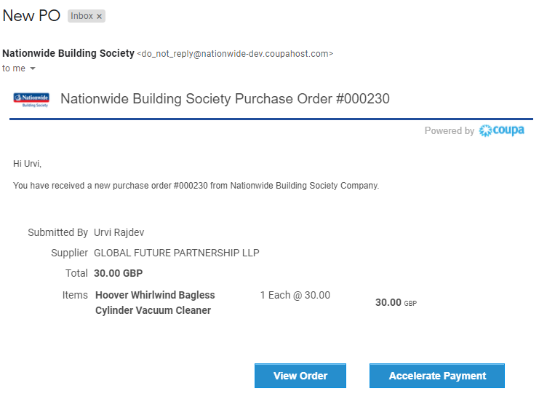
Viewing a Purchase Order
If you enable email notification for POs, you will receive an email notification for the new PO.
Open the email and click View Order. This will open the CSP - where you can view the PO.

Slide 6
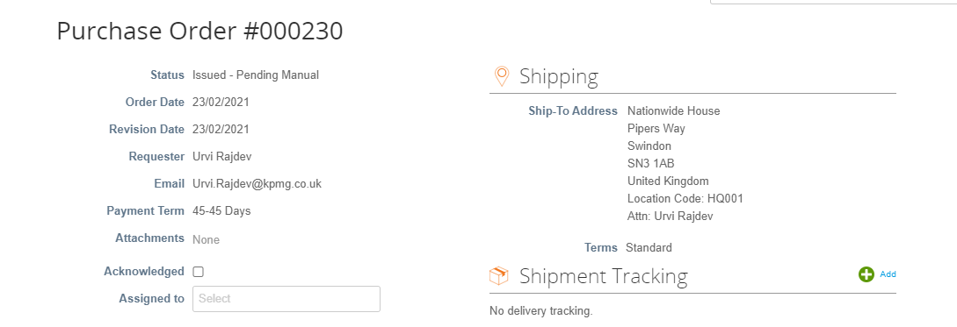
Viewing a Purchase Order
The below descriptors will help you understand what each of the data points mean on your PO’s.
Status: The status of the PO.
Order Date: The date that the PO was created.
Revision Date: Date the PO was revised. If the PO does not have any revisions this will be the same as the Order Date.
Requester: The name of the Requester.
Email: The E-mail address of the Requester.
Payment Term: Payment term.
Attachments: Attachment from the Requester.
Acknowledge: Allows you to acknowledge the purchase order
Assigned to: Assign this PO to a user that is set up in your CSP account
Shipping: The ship-to address
Terms: Shipping term
urvi.rajdev@nationwide.co.uk
Shipment Tracking: Allows you to create shipment tracker for this order
Select Customer: The name of the customer that sent that PO

Slide 7
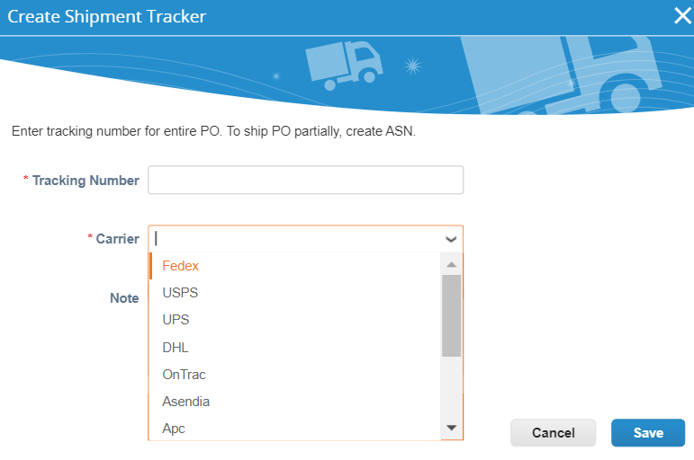
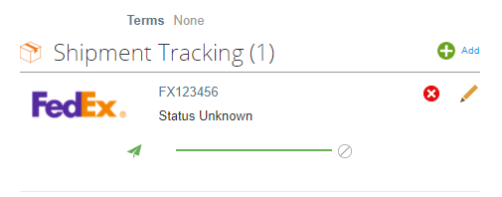
Viewing a Purchase Order
If you wish to provide shipping information for this entire PO. Click on the Add button at the Shipment Tracking section, then enter Tracking Number and select a Carrier from the drop-down list.
Click Save.

Slide 8
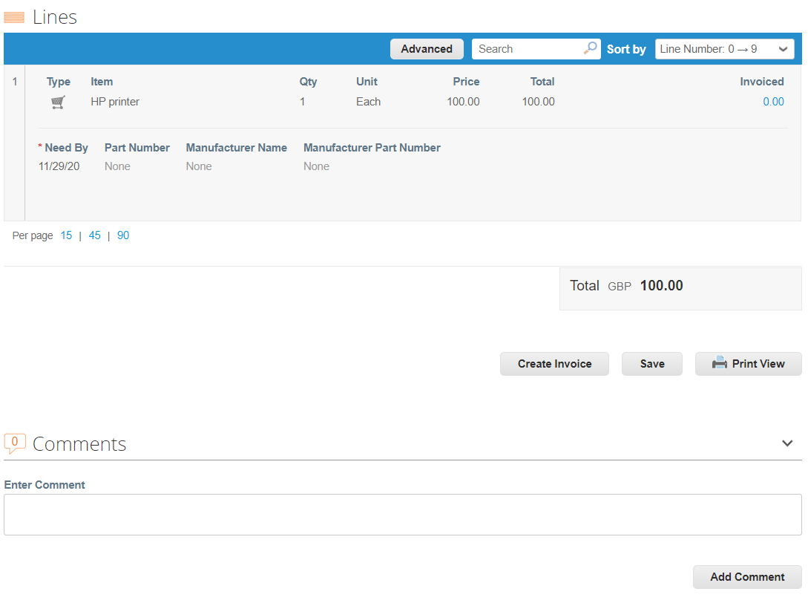
Viewing a Purchase Order
You will also be able to take some contextual actions from the PO.
14. Lines: Line-level information for each PO.
15. Print View: Allows you to view the print view of the PO.
16. Create Invoice: Allows you to flip the PO to an invoice.
17. Add Comment: Allows you to add comments to Nationwide.

Slide 9
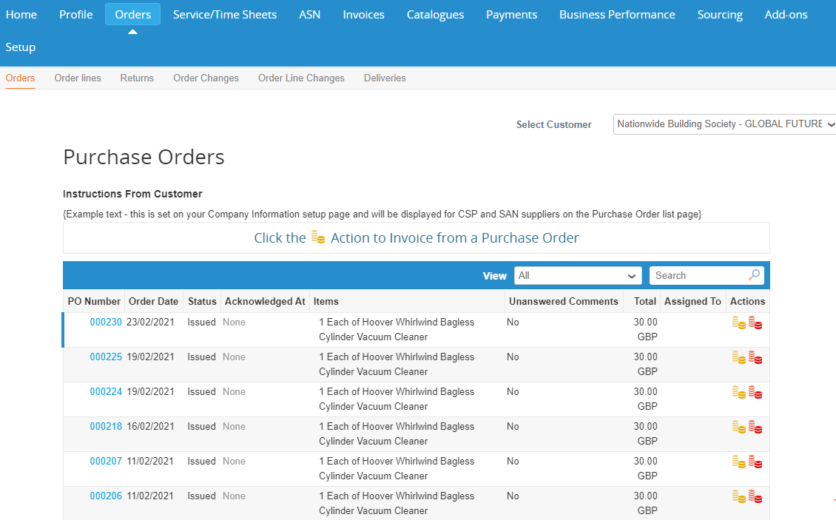
Viewing a Purchase Order
The below covers an alternative way to view your Purchase Orders.
You can also view all your Purchase Orders from CSP directly.
Go to your CSP account, and click on Orders at the top
Select Nationwide from the Select Customer drop down
On top of all the POs, there is instruction from Nationwide at the Instructions From Customer field
Click on the PO number that you wish to view

Slide 10
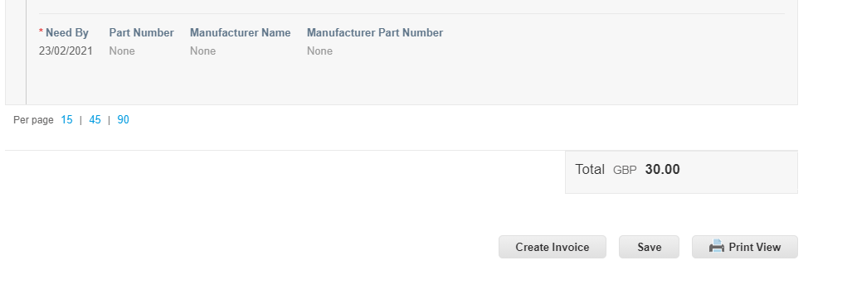
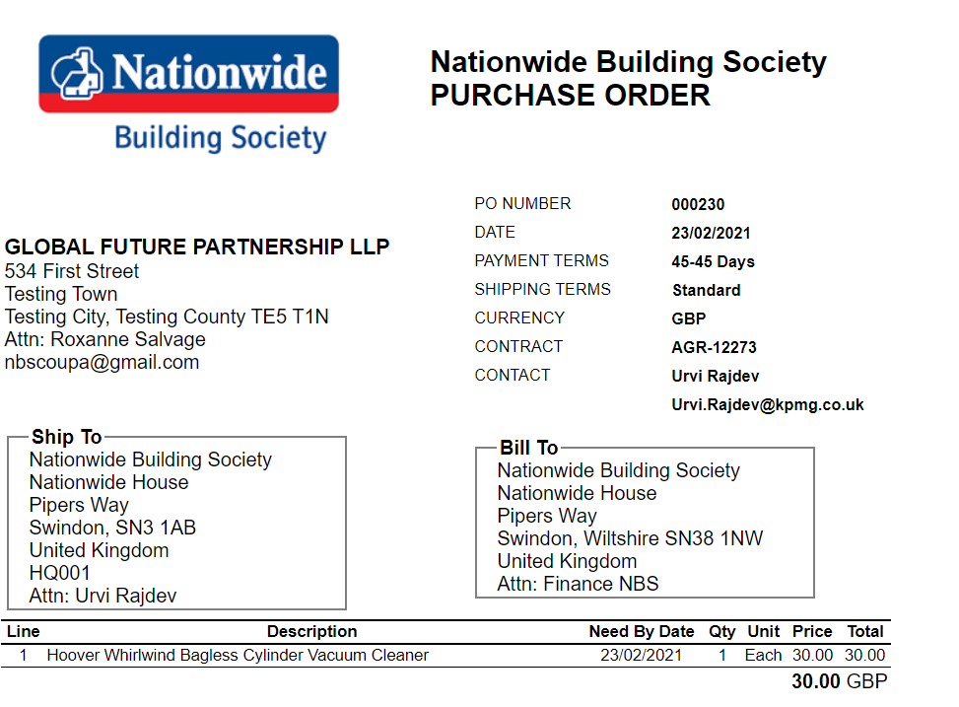
Viewing a Purchase Order
Clicking on Print View will allow you to view a print friendly version of the PO - which will include a link to the terms and conditions.

Slide 11
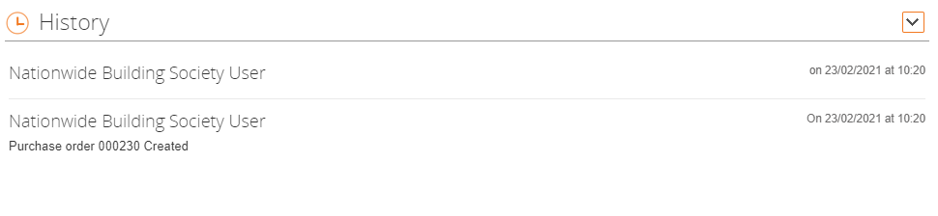
Viewing a Purchase Order
At the bottom of the PO, there is History. Expand it and you can see records all the historical activities of the PO.

Slide 12
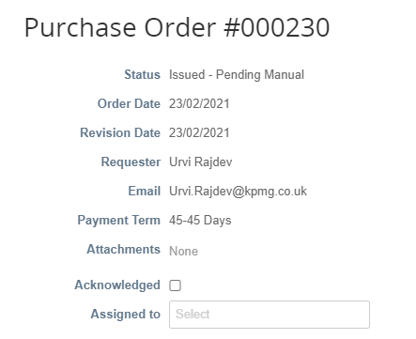
Viewing a Purchase Order
To acknowledge the PO, click the Acknowledged checkbox.

Slide 13
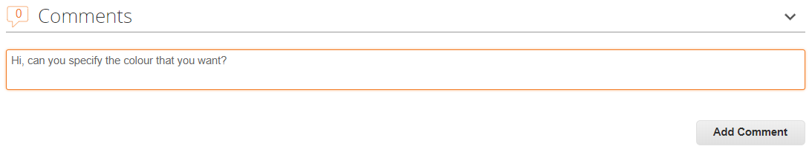
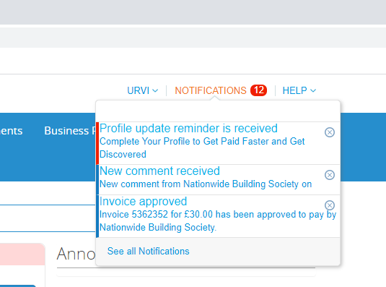
Viewing a Purchase Order
You can make comments that are visible to Nationwide as well as review comments that Nationwide have made on Purchase Orders..
To add a comment for Nationwide, enter your comment in the Comments box at the bottom of your PO and then click Add Comment.
When Nationwide responds, you will receive a Notification via email and and will also be able to see their response in the CSP. All comments entered here will be viewable to Nationwide.

Slide 14
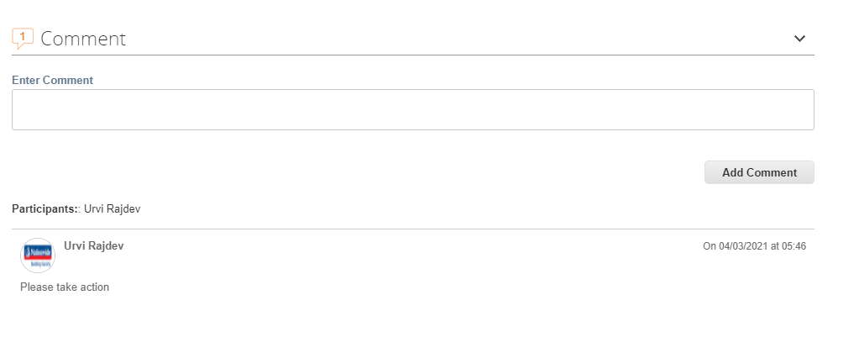
Viewing a Purchase Order
The comment history can be found in the Comments section at the bottom of the PO

Slide 15
Flipping a PO into an Invoice

Slide 16
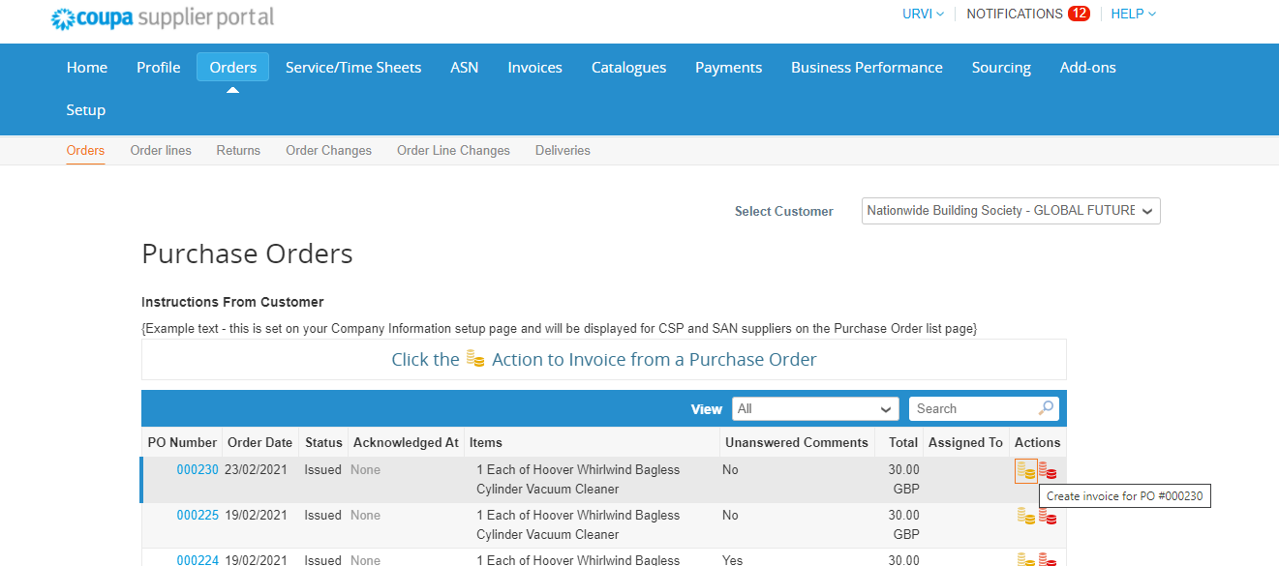
Creating Invoices: Flipping a PO into an Invoice
Coupa enables you to ‘flip’ a Purchase Order into an Invoice, making the process of invoice creation simple and straight-forward.
Click on the Orders tab.
Search for the purchase order to be invoiced and click on the gold coin stack icon to create the invoice.

Slide 17
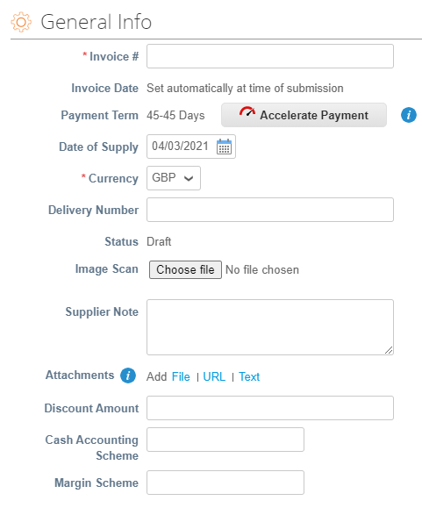
Creating Invoices: Flipping a PO into an Invoice
Complete header level fields. Please ensure that the information used to generate the invoice from Coupa is the same data from your own ERP system.
  Invoice #: Enter the invoice number generated in your own ERP system.
  Invoice Date: Set automatically at time of submission.
  Payment Terms: The payment terms from the PO.
  Date of Supply: The date on which the goods or services were provided.
  Currency: The currency from the PO.
  Delivery Number: Provide if applicable.
  Status: The current status of this invoice.
  Image Scan: Please do NOT attach a copy of an invoice from your system. As per the T&Cs agreed, Coupa will issue the legal invoices on your behalf.

Slide 18
Creating Invoices: Flipping a PO into an Invoice
4. Supplier Note: Enter any notes for Nationwide.
5. Attachments: Attach supporting documentation; all types of attachments are supported. If requested by Nationwide, please upload your break down of costs in the agreed Coupa format here (Excel).
6. Cash Accounting Scheme: Leave blank if not relevant.
7. Margin Scheme: Leave blank if not relevant.

Slide 19
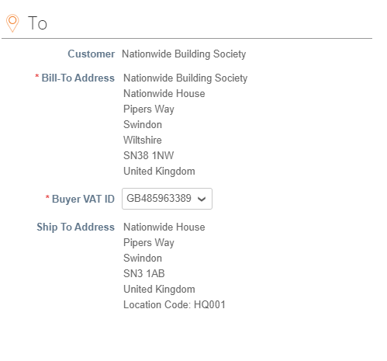
Creating Invoices: Flipping a PO into an Invoice
8. Customer: This will always default to Nationwide.
9. Bill to Address: The Bill To address from the PO. It will appear after you pick a Buyer VAT ID.
10. Buyer VAT ID: Choose a NBS VAT ID that is applicable for this transaction from the drop down.
11. Ship To Address: The Ship To address from the PO.
Please NOTE:
Please refer to section 5. Tax Guidance on instructions of how to pick your VAT ID and NBS VAT ID.
You can add multiple From info in the Legal Entity Setup section under Setup and select these options by clicking the search icon.

Slide 20
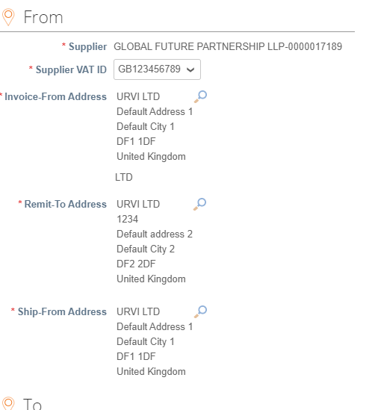
Creating Invoices: Flipping a PO into an Invoice
  Supplier: Your company name.
  Supplier VAT ID: This filled will be defaulted if you only have one VAT ID setup for this legal entity. If you have multiple VAT IDs, choose the VAT ID that you set up in the Legal Entity Setup section in Setup. If you have multiple VAT registrations, please ensure you choose the correct VAT registration based on the Country you have supplied your goods or services. Coupa will have different invoicing rules based on the Country of the VAT registration that you have selected for the invoice (and in line with VAT law of that country).
  Invoice From Address: Choose the Invoice From Address that you set up in your Legal Entity Setup section in Setup for this invoice.
  Remit-To Address: Choose the Remit-To Address that you set up in your Legal Entity Setup section in Setup for this invoice.
  Ship From Address: Choose the Ship From address that you set up in your Legal Entity Setup section in Setup for this invoice. If you have multiple, please ensure it is the correct address which relates to where the goods are shipped from for this specific transaction.

Slide 21
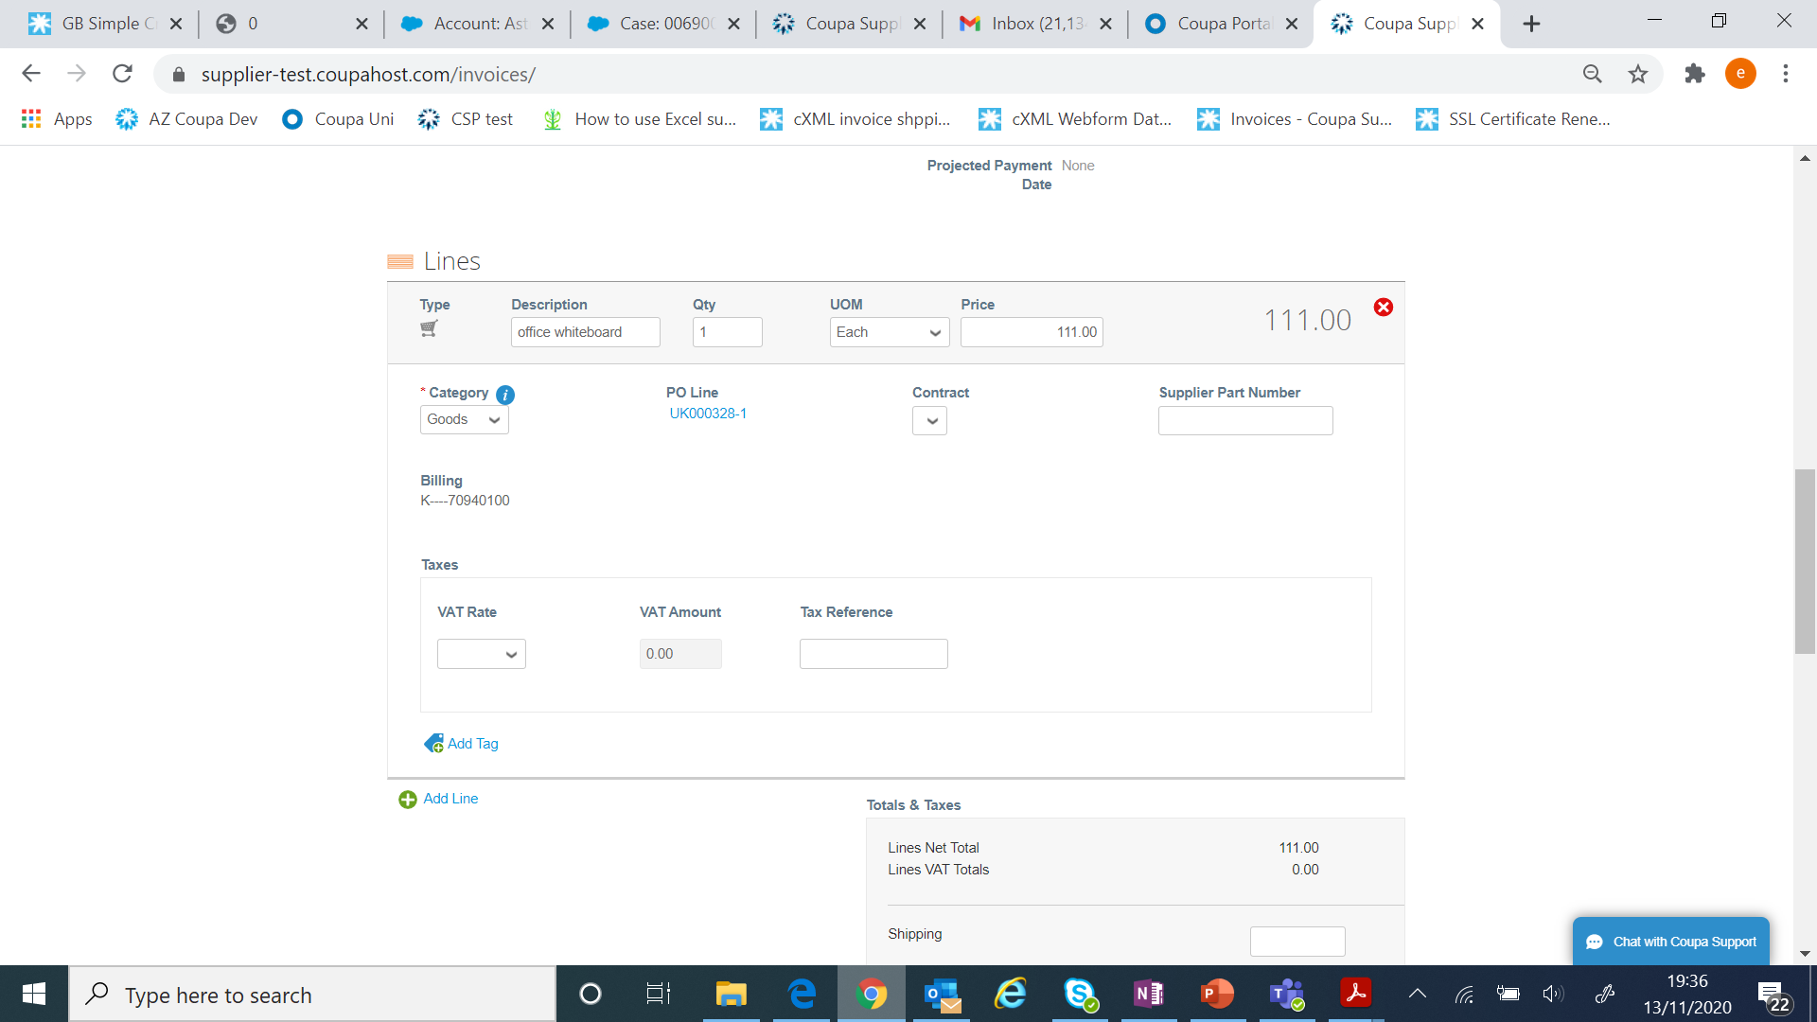
Creating Invoices: Flipping a PO into an Invoice
1. Complete line level information. Here you may edit the Quantity/Price if you are sending a partial invoice.
  2. Category: Select Goods or Services
  Taxes: Add a VAT Rate for each line level item. VAT rates available will be driven by your invoicing country.
  Tax Reference: For zero rated and exempt transactions, Coupa will require you to enter a “relevant reference or any indication” for these items” to indicate why the supply is not subject to VAT.
  Please NOTE: It is important the VAT rate is correct in terms of the supplies being made and the place of supply for tax purposes and the VAT charged and invoice references on your invoice match entries you have made in your VAT records.
  Please refer to section 5. Tax Guidance on instructions of how to pick the correct VAT rates.

Slide 22
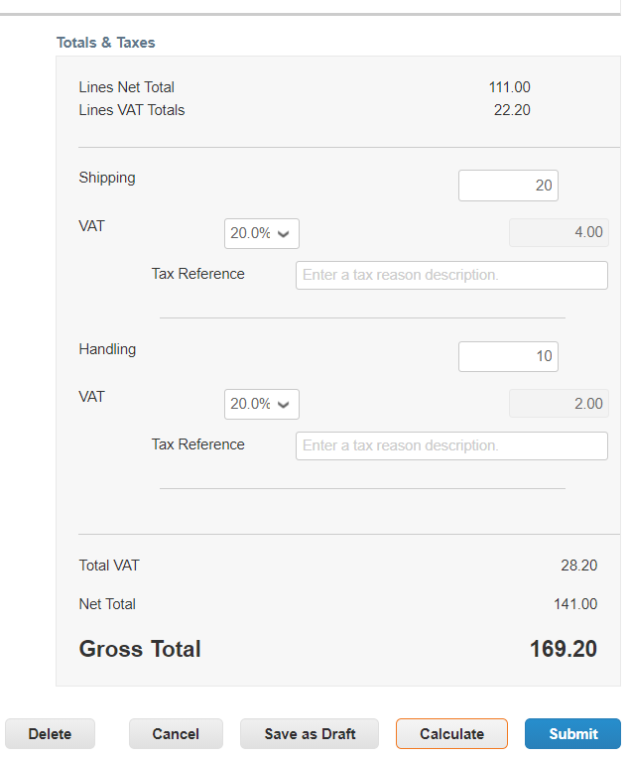
Creating Invoices: Flipping a PO into an Invoice
  3. After completing all the invoice information, click Calculate. This will then work out the total and validate that all mandatory fields have been completed .
Please Note:
Where you are supplying items where different VAT rates are applicable to the same PO line, please split these onto multiple invoices.

Slide 23
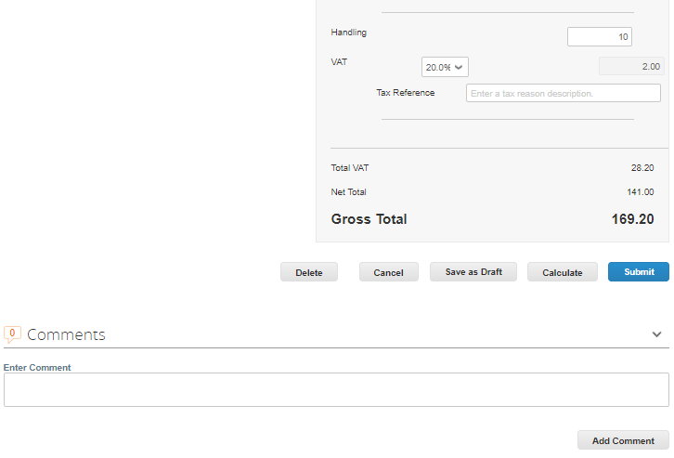
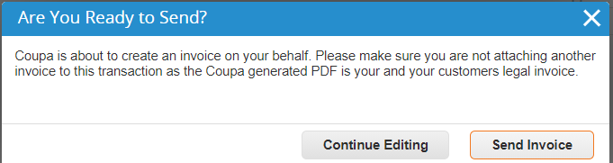
Creating Invoices: Flipping a PO into an Invoice
4. To add a comment for Nationwide, enter your comment in the Comments box and then click on Add Comment.
When Nationwide responds, you will receive a notification and will also be able to see their response here.
All comments entered will be viewable to Nationwide. The comment function for invoices is the same as it for PO.
If you want to save the invoice for later, click Save as draft. If you are ready to submit the invoice, click Submit and then click Send Invoice in the pop-up confirmation window.

Slide 24
Creating Credit Notes

Slide 25
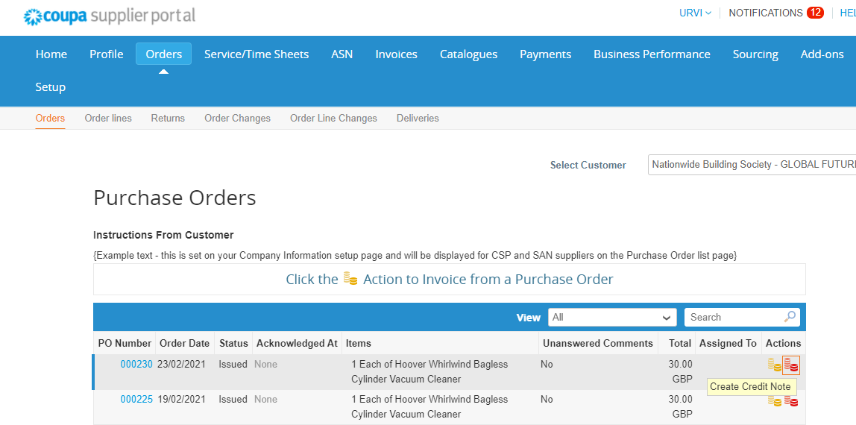
Creating Credit Notes
Coupa also enables you to create Credit Notes directly from within the CSP. This section will walk you through how to complete these.
Please Note:
Any disputed invoices by Nationwide will need to be resolved by issuing a credit note.
Click on the Orders tab.
Search for the purchase order to be credited and click on the red coin stack icon to create credit note.

Slide 26
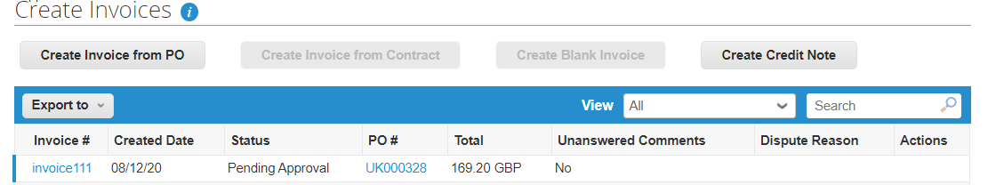
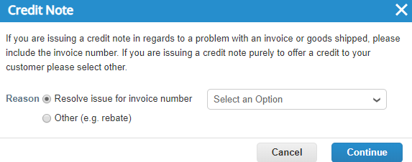
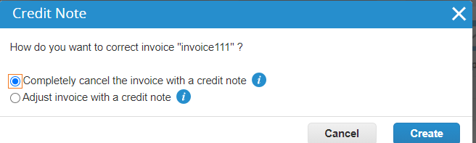
Creating Credit Notes
Click the Invoices tab. Then click Create Credit Note
Select the invoice number from Resolve issue for invoice number that you want to create a credit note against. Then click Continue.
Choose from Completely cancel the invoice with a credit note or Adjust invoice with a credit note. Then click Create.
  The example used over the following pages is a partial credit note.

Slide 27
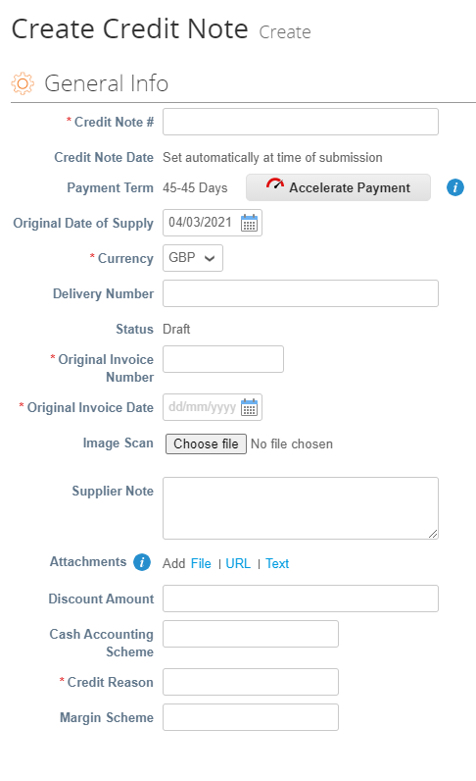
Creating Credit Notes
Complete header fields. Please ensure that the information used to generate the Credit Note in Coupa is the same data from your own ERP system.
  Credit Note #: Enter the credit note number generated in your own ERP system.
  Credit Note Date: Set automatically at time of submission.
  Payment Terms: These are the payment terms from the PO.
  Original date of supply: PO issued date.
  Currency: This is the currency from the PO.
  Delivery Number: Driven by the original invoice.
  Status: Current status of this credit note.
  Original Invoice #: Reference the original invoice number for this credit note.
  Original Invoice Date: Reference the original invoice date for this credit note.
  Image Scan: Please do NOT attach a copy of the credit note from your system. As per the T&Cs agreed, Coupa will issue the legal credit note on your behalf.
  Supplier Note: Enter any notes for Nationwide.

Slide 28
Creating Credit Notes
Attachments: Attach supporting documentation; all types of attachments are supported. Please do NOT attach a copy of the credit note from your system. As per the T&Cs agreed, Coupa will issue the legal credit note on your behalf.
Cash Accounting Scheme: Leave blank if not relevant.
Discount Amount: Leave blank if not relevant.
Credit Reason: Briefly explain the reason for the credit note.
Margin Scheme: Leave blank if not relevant.
.

Slide 29
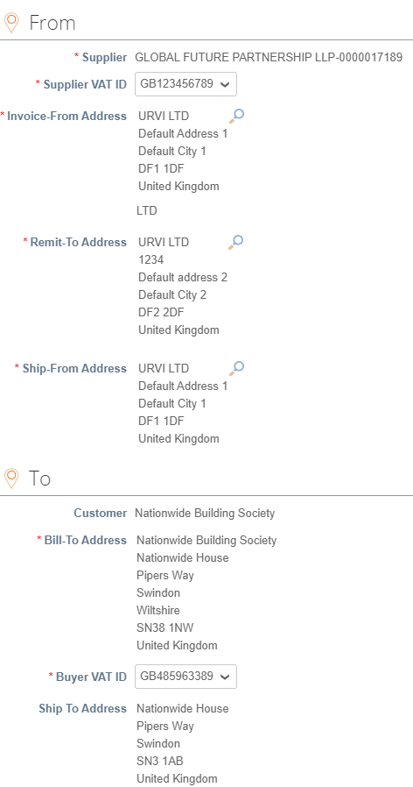
Creating Credit Notes
Complete header level fields.
The From and To section will be defaulted based on what you have in the original invoice.

Slide 30
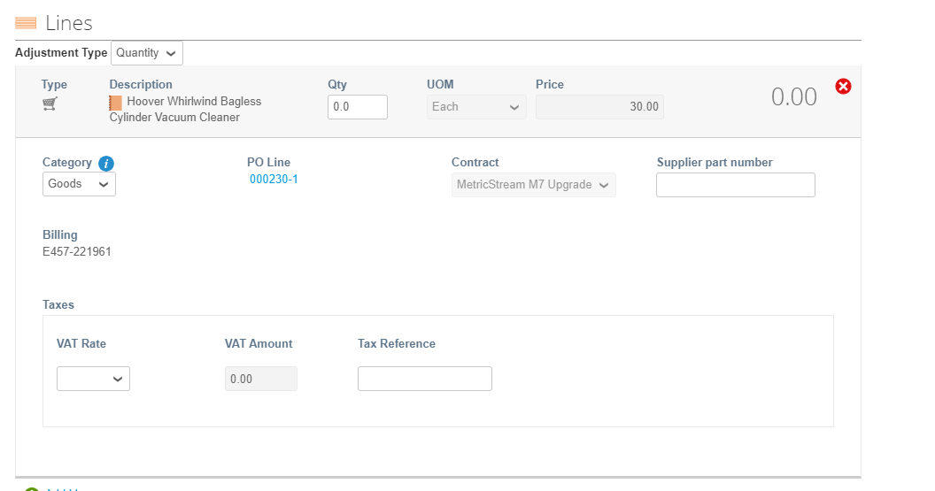
Creating Credit Notes
Complete line level information. Here you may edit the Qty and/or Price if you are sending a partial credit note. Click Adjustment type and choose Quantity, Price or Other. You can edit both quantity and price if you choose Other.
  You can also delete lines by clicking the delete icon.
  You can then add any applicable Tax by choosing the correct VAT Rate for each line. The VAT rate would typically be the same as that applied to the original invoice.
  Please NOTE: For Credits, enter a negative price of the line is amount-based and only contains a price field.
  If the line is quantity-based, enter a negative quantity and leave the price as positive.

Slide 31
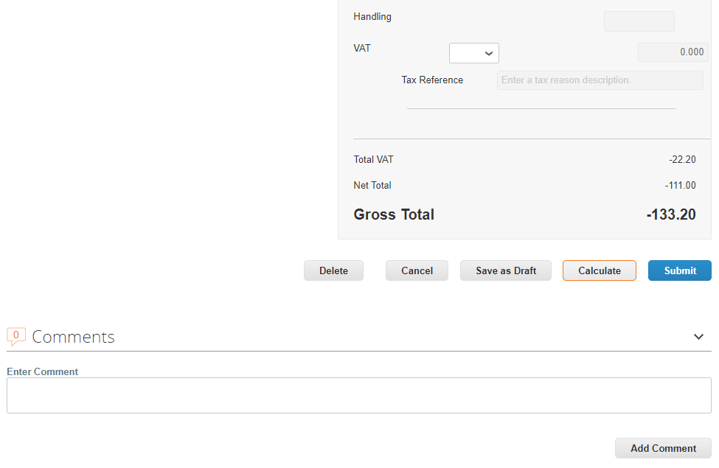
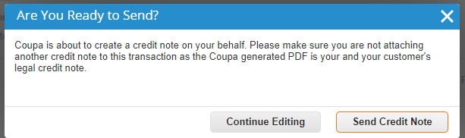
Creating Credit Notes
  Click Calculate. This will work out the new total for the credit note.
To add a comment for Nationwide, enter your comment in the Comments box and click Add Comment. When Nationwide responds, you will receive a notification and will also be able to see their response here.
All comments entered here will be viewable to Nationwide. The comment function for credit note is the same as it for PO and invoices.
  If you want to save the credit note for later, click Save as draft. If you are ready to submit the credit note, click Submit and then click Send Credit note in the pop-up confirmation window.

Slide 32
Viewing Invoices & Credit Notes

Slide 33
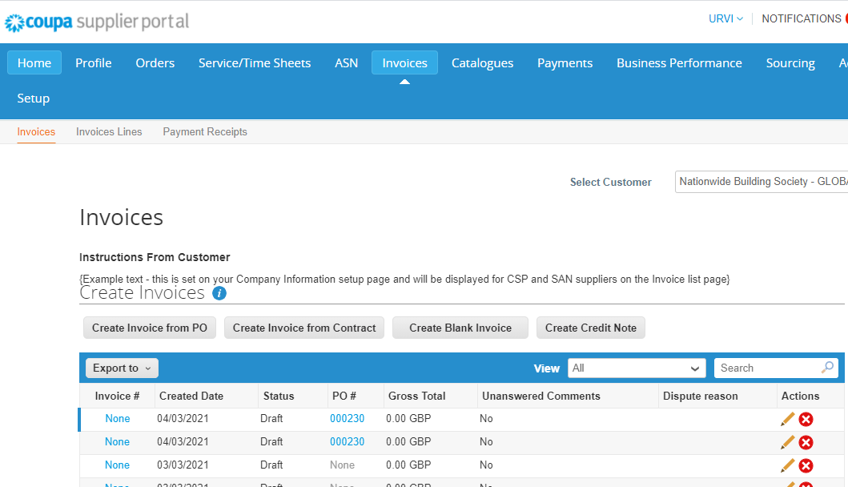
Viewing Invoices and Credit Notes
You can see the status of an invoice & credit note by clicking Invoices from the top menu bar and looking up the Status column.
On top of all the invoices, there is instruction from Nationwide at the Instructions From Customer field.
The Status explanations are as follows:
Approved: The invoice/credit note has been accepted for payment by Nationwide.
Disputed: The invoice/credit note has been disputed.
Draft: The invoice/credit note has been created, but it hasn't been submitted to your customer yet.
Invalid: Specific for compliant e-invoices for clearance countries, for example, Mexico. It indicates that a CFDI (Mexican legal invoice form) that you sent failed validation. Invoices with this status are visible only to you, not to your customer.
Pending Approval: The invoice/credit note is currently under review by your customer.
Processing: The invoice/credit note is being processed by the Accounts Payable department and should be paid soon.
Voided: There's something wrong with the invoice/credit note. Contact your customer to get the invoice/credit note back on track.
Abandoned: The disputed invoice has been abandoned. Your customer can choose to notify you of this invoice status change and provide instructions. You can set notification preferences for abandoned invoices.

Slide 34
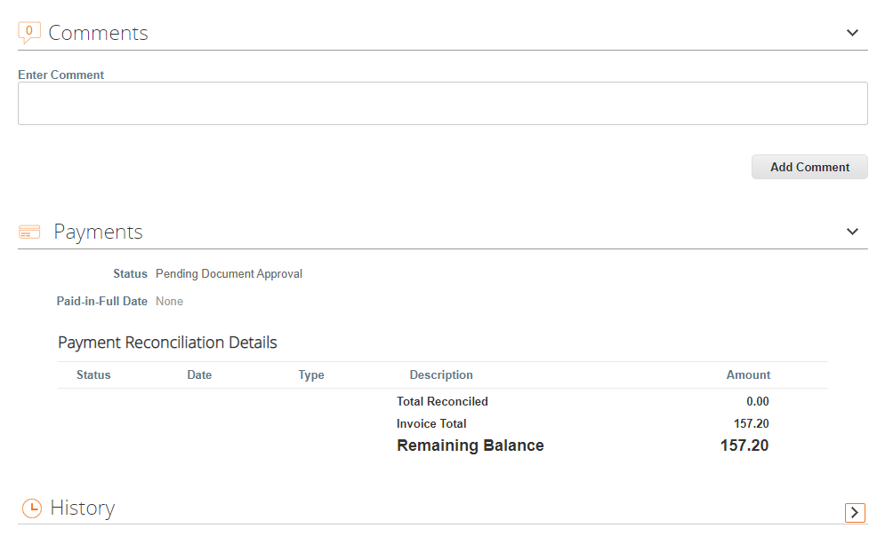
Viewing Invoices and Credit Notes
Click and open an invoice.
Scroll down and expand the Payments section. You will see the payment information of that invoice.

Slide 35
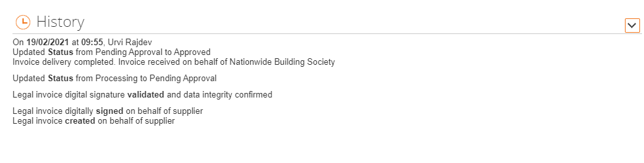
Viewing Invoices and Credit Notes
At the bottom of the invoice or credit note, there is History. Expand it and you can see all the historical activities of the invoice or the credit note.

Slide 36
Tax Guidance

Slide 37
Tax Guidance
You should ensure that the correct VAT is charged on your invoice. The VAT rates that are available to choose in CSP when you create invoices are driven by your invoicing country.
Please ensure that there is only one applicable VAT rate per invoice line, for example, 20% or 5%. Where you are supplying items where different VAT rates are applicable, please split these onto multiple invoice lines.
Please note that there are 3 different “Zero” tax treatments in Coupa and each have different meanings. Please see below compliance requirements for them on invoices.
  Zero rated transactions: These are transactions which are subject to VAT, but the VAT rate is 0%. Please note that Coupa will require you to add a “relevant reference or any indication” to show why these goods are zero rated (e.g. VAT zero-rate: International freight).
  Exempt transactions: These are transactions that are exempt from VAT. Please note that Coupa will require you to add a “relevant reference or any indication” to show why these goods are Exempt (e.g. VAT Exempt: Insurance).
  Self-accounted VAT (reverse charge): These are transactions where the customer (NBS) is liable to self-account for any due tax. This typically relates to exported services but may apply to specific types of goods supplied in the UK. Please add the reference “Reverse Charge or locally required text” to indicate that the reverse charge is applicable.

Slide 38
Close slide dark blue

